Slide 1
Robocar VIoT: A Voice and IoT
Controlled Robotic Car
Presented by –
Naimur Rahman
Roll: 1907031
Md. Abu Saeed
Roll: 1907057
Supervised by – Dr. Md. Sheikh Sadi Sir

Slide 2
Overview
Objectives, Basic Concept and Background
System of Android App
System of Communication
System of Hardware Implementation
Issues and Solutions
Application, Future work and Conclusions

Slide 3
Objectives
To seamlessly integrate Bengali voice commands and remote-controller style controls, offering users flexible robotic car control
To prioritize user-friendliness, providing an adaptable interface for both long-range IoT and short-range Bluetooth interactions
To enable precise control via Bluetooth, ensuring direct and responsive user control through the Android app

Slide 4
Basic Concept
A robotic car
controlled via Android App
with Bengali voice control or traditional remote controller system
by the medium of IoT (Internet of Things) in case of long range
or Bluetooth in case of short range communication

Slide 5
System
Can be divided into 3 separate sectors:
Android App
Communication System
Hardware system

Slide 6
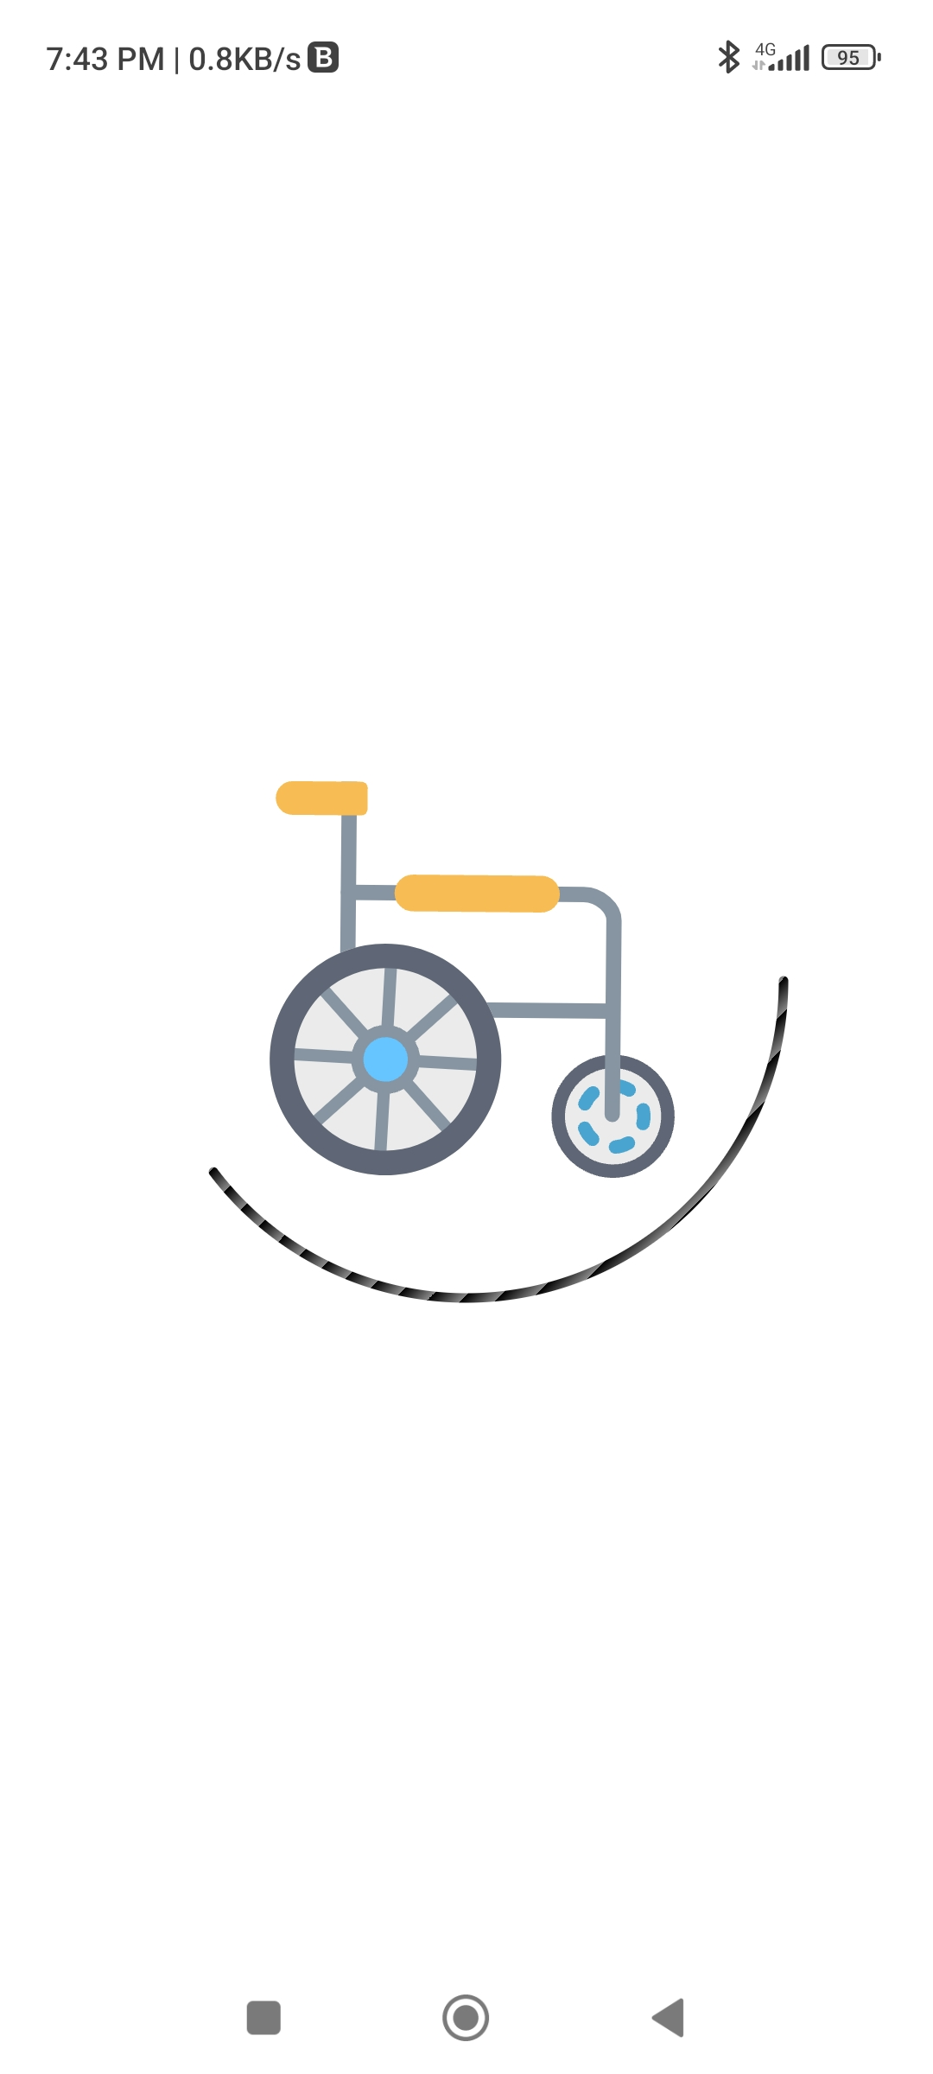
Android App
Consists of several components:
Login system
Connection establishment
Camera view
Speech recognition API
Remote controller
Log cats

Slide 7
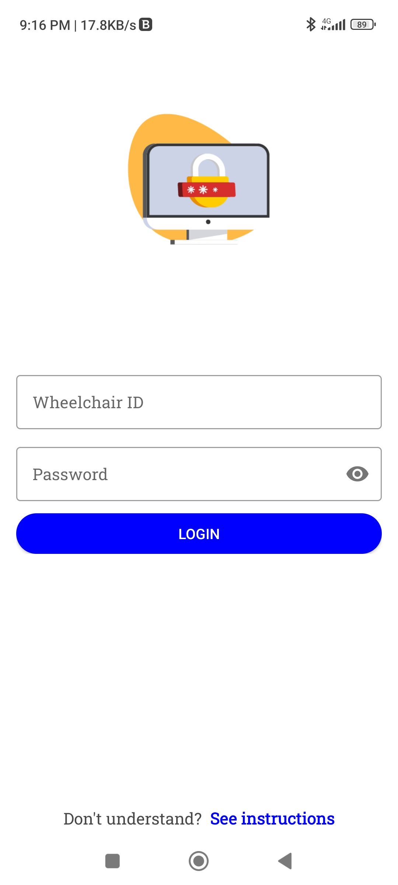
Login System
Requires ID & Password
The ID & password will be provided by the manufacturer
That will only be applicable for one specific robocar
User instructions are added in this page to navigate the App

Slide 8
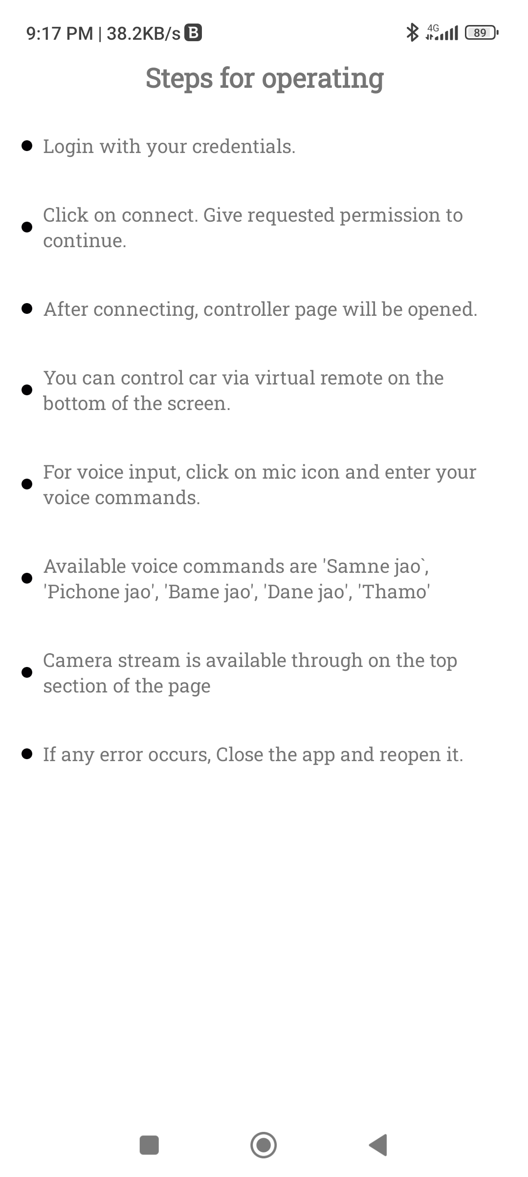
Login System (continued)
Robocar ID accesses the specific robocar
ID attached directly into the database with the password
Correct credentials will navigate to the connection establishment page
This ID uniquely identifies each car

Slide 9
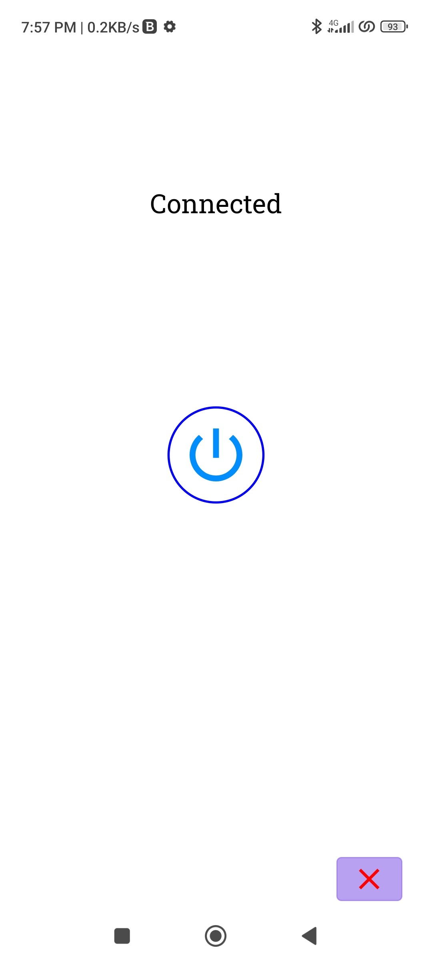
Connection Establishment
Consists of a singular button
Upon pressed tries to establish connection
Establish connection only if Rock-PI is active
Initializes basic configuration for connecting
Connect with Firebase database and Web Socket
Done to save data of the user
Basically an ON-OFF switch

Slide 10
Database
2 different database/medium are used:
Web Socket for only sending commands
Less latency
Less protection
Commands is implemented
Firebase database for Login, Log cats etc.
More latency due to extra protection layers
More protection

Slide 11
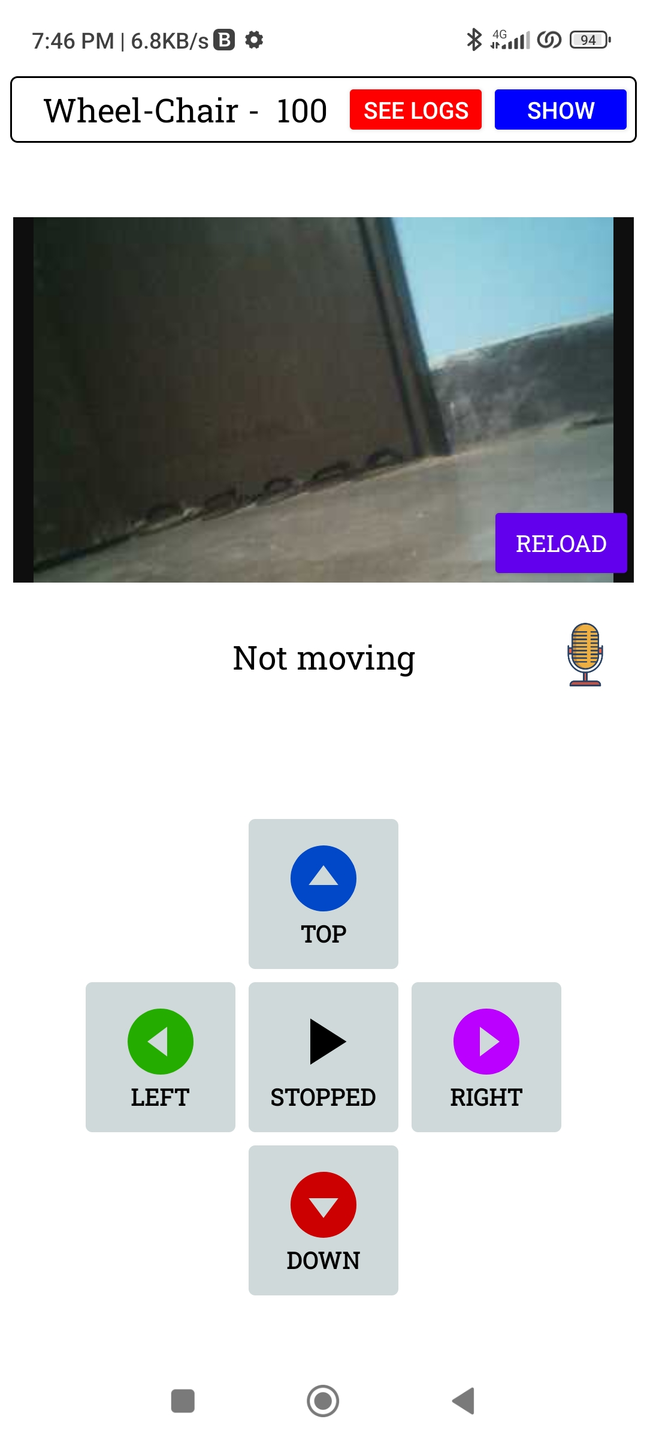
Camera View
Views the video stream provided by the Rock-Pi
Uses Web Socket with remote stream
High latency due to large data passing

Slide 12
Voice control
Google speech recognition API used
Listens to the user voice commands
Converts speech to text strings
Bengali Language model is used
Uses 5 sperate commands

Slide 13
Bengali Voice Commands
সামনে যাও (Samne Jao) -> Forward Command
পিছনে যাও (Pichone Jao) -> Backward Command
বামে যাও (Bame Jao) -> Left Command
ডানে যাও (Dane Jao) -> Right Command
থামো (Thamo) -> Stop Command
These commands are first optimized by the Levenshtein algorithm

Slide 14
Levenshtein Algorithm
An optimization algorithm
Also known as the Edit Distance algorithm
A dynamic programming technique used to measure the similarity between 2 strings
Calculates the minimum number of single-character edits required to transform one string into the other
employed to enhance the accuracy of recognizing spoken commands

Slide 15
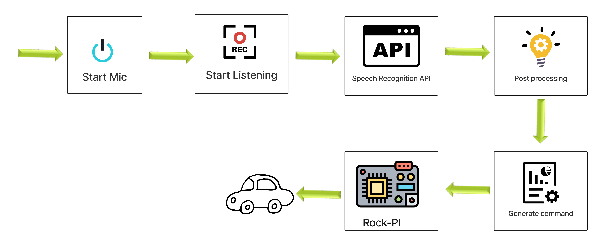
Voice Command System (Continued)
Figure-1: Voice command system

Slide 16
Remote Controller
Optimized strings and button pressed inputs both are converted into integer values:
Forward -> 3
Backward -> 4
Left -> 1
Right -> 2
Stop -> 5

Slide 17
Voice Command System & Remote Controller
(Continued)
Integer values are passed via Web Socket for IoT communication
Also passed through Bluetooth system if with in range
These values are later read by the micro-controller

Slide 18
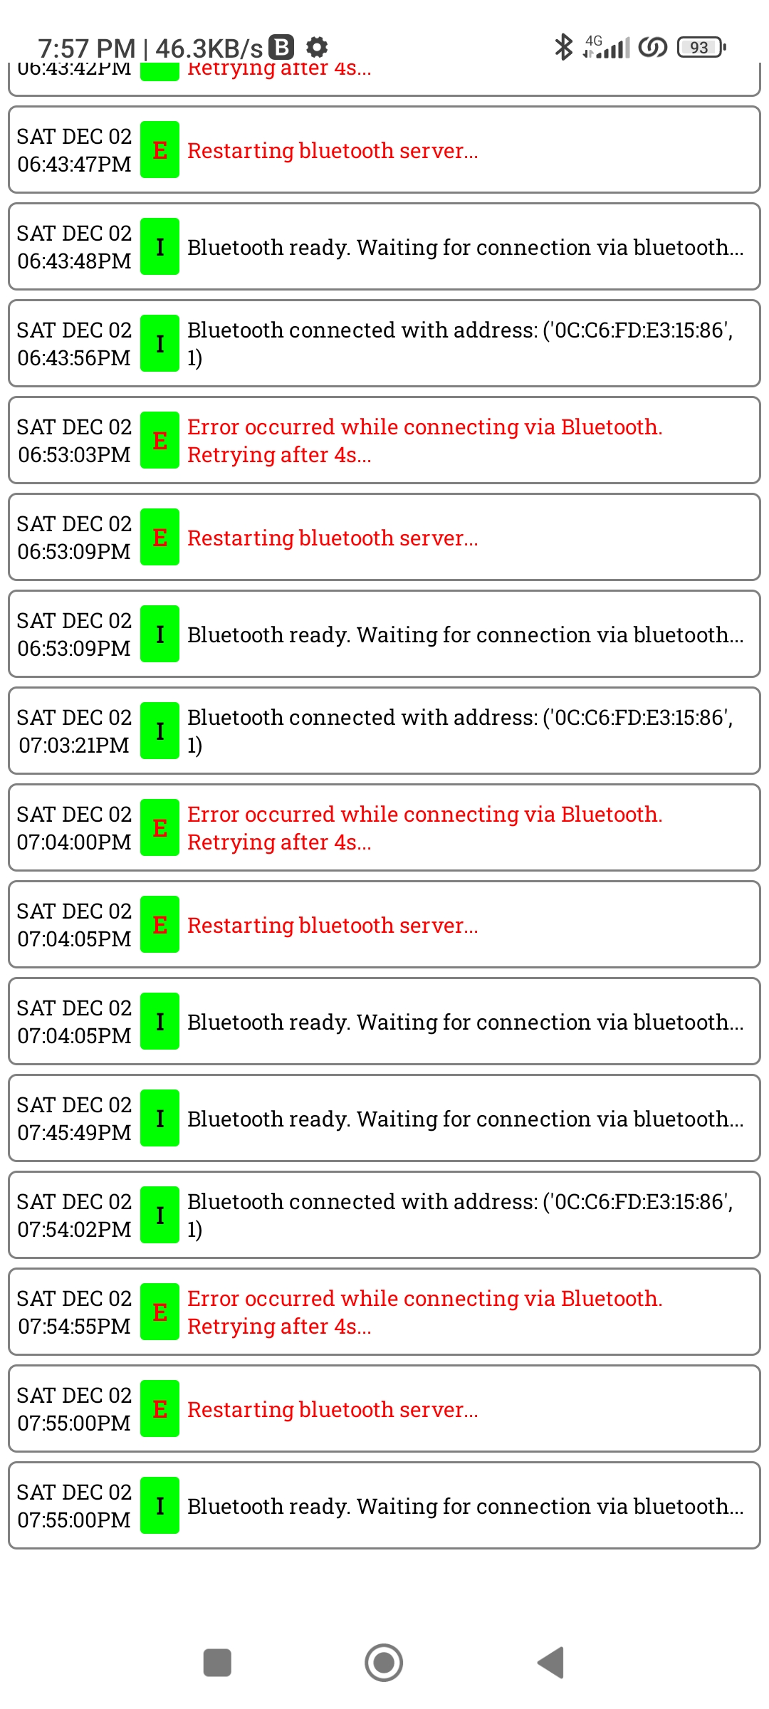
Log Cats
Shows connection and communication status
Back communication by the micro-controller are shown
Notifies errors
Also shows executed commands in the micro-controller

Slide 19
Communication System
2 Methods:
IoT (Internet of Things)
Bluetooth

Slide 20
IoT (Internet of Things)
Long range data communication
Accessed using internet
Uses Web Socket
Takes input from user via Android App using voice or remote controller
Sends command data via WebSocket
Reads data in micro-controller and executes it

Slide 21
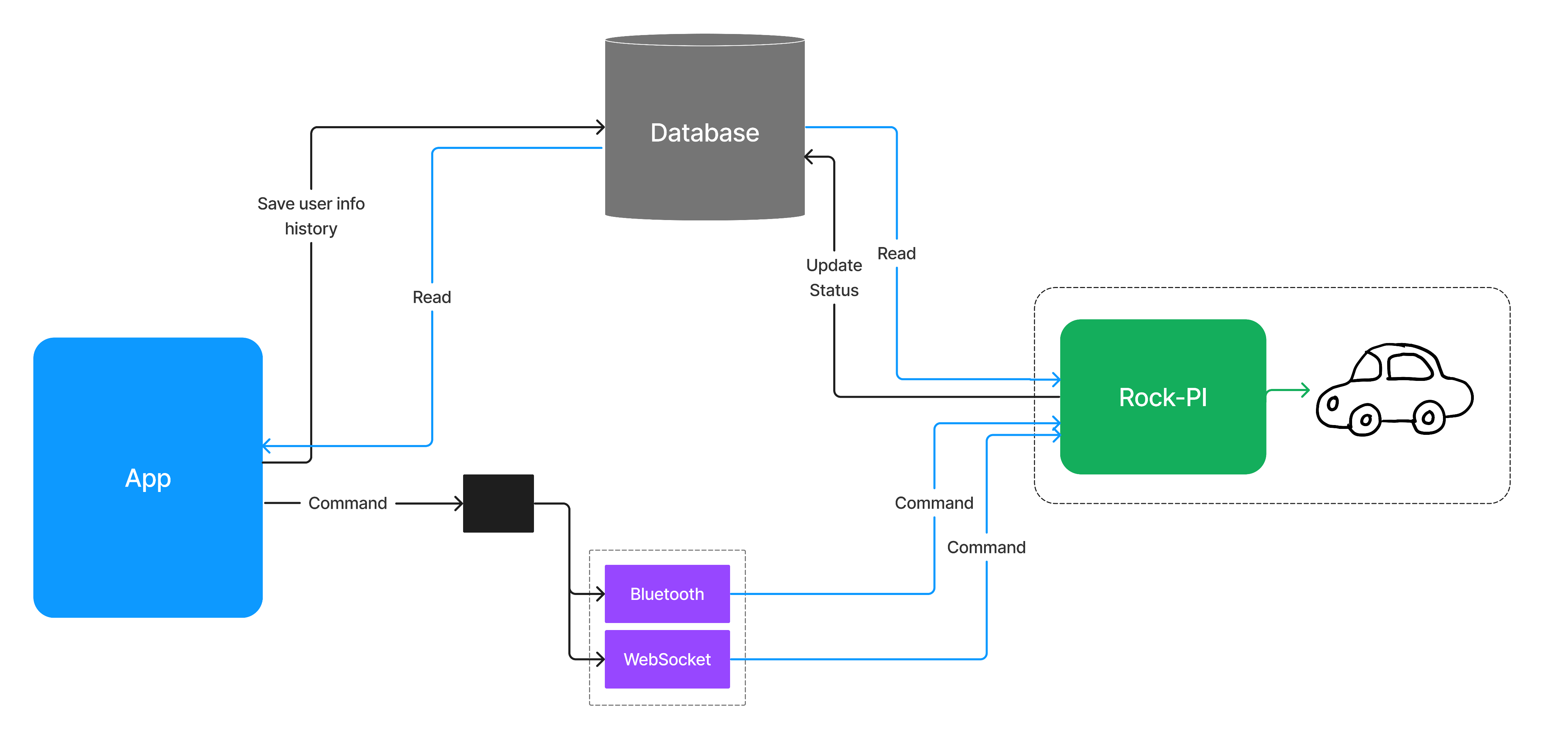
IoT (Internet of Things) (continued)
Figure-2: IoT communication system

Slide 22
IoT (Internet of Things) Issues: Latency
Occurs due to internet speed and read write operations
High speed internet access in both app and micro-controller can minimize the effects
Using Web Socket has significantly less latency than Firebase database
Sacrificed data protection for latency reduction
22

Slide 23
Bluetooth
Short range data communication
Accessed locally
Very low to no latency
Need to accept connection in micro-controller
A range of approximately 20 meter radius
Constantly checks for local connection
Tries to reconnect after every 2.5 sec when error occurs

Slide 24
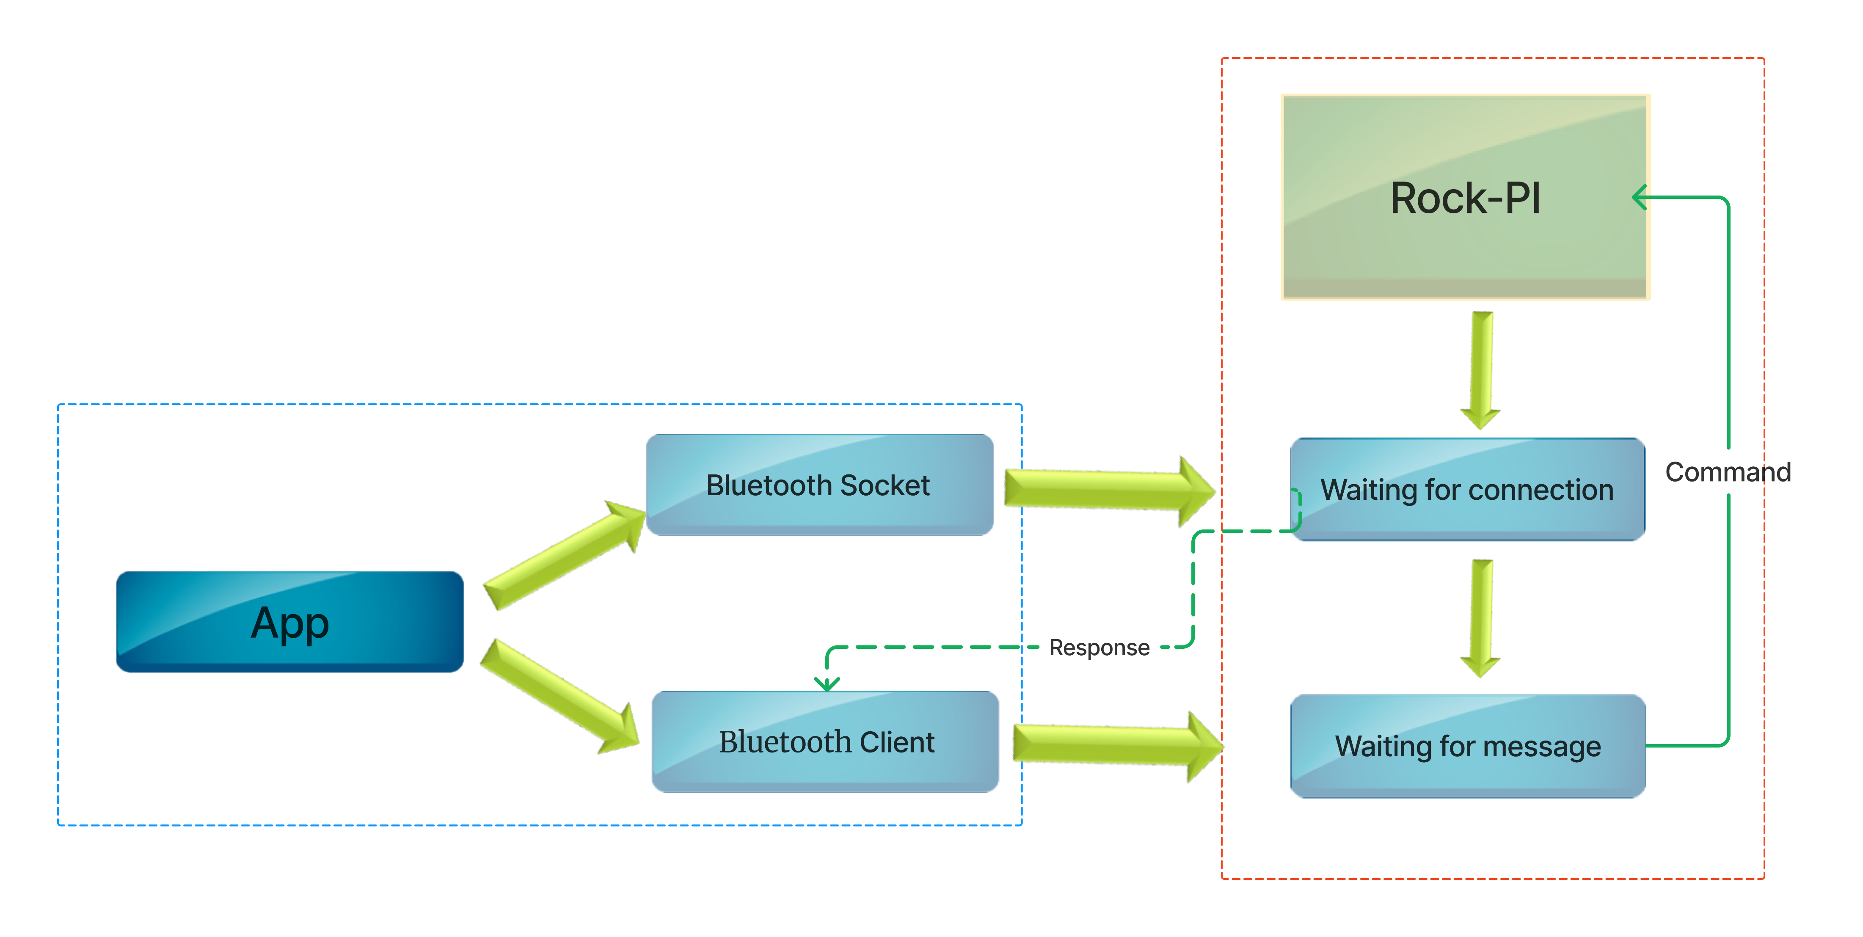
Bluetooth (continued)
Figure-3: Bluetooth communication system

Slide 25
Hardware System
4 main components:
Rock Pi 3a Micro-controller
L293D Motor Driver
Web-Cam
Python scripts through Debian OS from the micro-controller

Slide 26
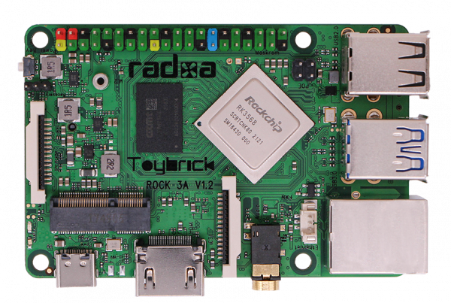
Rock Pi 3a
Advanced version of Raspberry Pi
Based on the Rock Chip RK3328 processor
Contains quad core Cortex-A55 ARM processor
Frequency of 2Ghz
Additional GPU
Contains separate wireless module
40 pins in total including 28 GPIO

Slide 27
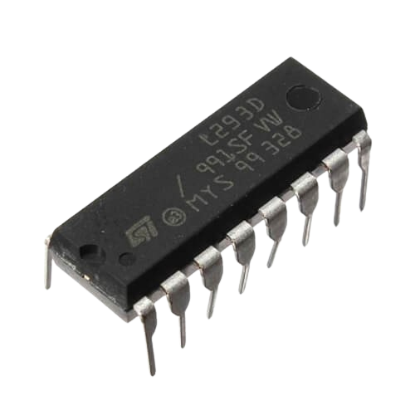
L293D Motor Driver
Interface between the Rock Pi 3a Micro-controller and the motors of the robotic car
Specifically designed for controlling the direction and speed of DC motors
Can drive two motors independently
Translates GPIO signals into precise control of the motors

Slide 28
Web-Cam
Used to capture footage ahead of the car
Uses a streaming method
Data is read through using micro-controller
Data passed via Web Socket
Data received by the app from Web Socket
Latency issues due to large data

Slide 29
Python Scripts
The software layer of the micro-controller
Reads data from database
Utilizes the GPIO pins to send signals to the L293D Motor Driver
Writes response back to the database
Implements communication in micro-controller for both IoT and Bluetooth

Slide 30
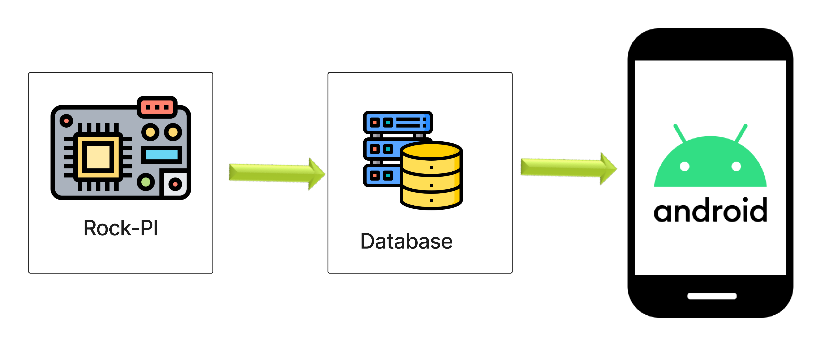
Python Scripts (continued)
Figure-4: Python script data passing to app

Slide 31
Additional Hardware Components
DC motors with wheels
3 x 3.7V Batteries for Power to micro-controller
2 x 3.7V Batteries for power to DC motors
Switch to control voltage flow to motors
Bread-Board
Connecting Wires

Slide 32
Issues
Multiple types of data arrives at the same time
Multiple types of data leaves at the same time
Might cause conflict in scheduling
Increases latency
Overlapped data could be lost

Slide 33
Solution
Parallel Execution
Multi-threading

Slide 34
Parallel Execution
Handled in micro-controller
2 different scripts
Camera Stream: Runs as a separate script as camera data is very large and causes the most latency so that it can’t effect the normal data exchange from the python scripts
Python Scripts

Slide 35
Multi-Threading
Handled in python scripts
4 different threads
Write/Update
Bluetooth
Socket/IoT
Read

Slide 36
Multi-Threading (continued)
Write/Update thread updates the responses to the database as log cats
Bluetooth thread handles data initialization and exchange from Bluetooth
Socket/IoT thread handles data regarding IoT communication
Read thread is an extra thread which is not implemented but kept as a backup for exchanging extra data with the app
Finally, data sending to L293D motor driver via GPIO pins is executed serially with the threads as it can be a result of multiple threads e.g. Bluetooth and IoT

Slide 37
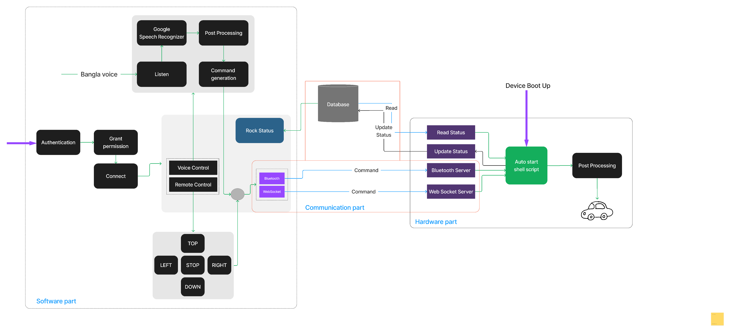
Complete System Architecture
Figure-5: Complete system architecture

Slide 38
Applications
Voice-controlled and IoT enabled wheelchair
Smart home assistance for people with disabilities
Telepresence robot for remote communication
Smart retail
Security systems
Smart agriculture
Research and exploration
Assistive robotics in healthcare

Slide 39
Future Work
Implement more advanced voice recognition models for enhanced accuracy and multilingual support
Investigate autonomous navigation capabilities, including obstacle detection and collision avoidance
Explore edge computing for real-time processing, reducing latency and enhancing responsiveness
Implement additional accessibility features, such as gesture-based controls, for a more inclusive design

Slide 40
Conclusions
Combined IoT, Bluetooth and Bengali voice Control System
Very few robotic systems with Bengali voice adaption
Could serve as a step towards futuristic robotic systems

Slide 41
Acknowledgement
Dr. Md. Sheikh Sadi Sir

Slide 42
Thank You

